Slide 1
Theorie Bioinformatica
Faster, better, stronger
Bioinformatics and functional genomics (3e) – Jonathan Pevsner (Wiley Blackwell)

Slide 2
De stof komt uit de college presentaties en Jonathan Pevsner "Bioinformatics and Functional Genomics"
(Wiley Blackwell; 3e editie) en een aantal extra papers
(deze worden expliciet in de betrokken colleges genoemd, en zijn te vinden onder "achtergrond").
College | Onderwerp | Hoofdstuk | Pagina's | Opmerkingen
1 | Recap Bioinf 1 | 3-4 | Zie Bioinf1 | Deze stof word t bekend verondersteld!
2 | Next Generation Sequencing | 9 | 377-423 | Niet de source code in je hoofd stampen!
3 | RNASeq | 11 | 479-515,519-528 | Niet de letterlijke R code, niet fig 11.17, 11.18, 11.19, 11.20
4 | Multiple Sequence Alignment | 6 | 205-217, 221-223 | Niet Box 6.3
8/9 | Assembly | 9/15 | 395-398,730-736 | Bestudeer ook de Powerpoint extra!
10 | The Burrough-Wheeler transform for mapping reads | 5
3 | Phylogeny | 7 | 245-289 | Niet Box 7.2,

Slide 3
Presentation content
Chapter 9: pg. 377 – 387 + additional materials

Slide 4
Part 1 Overview of NGS technologies and platforms

Slide 5
Terminology
NGS Next Generation Sequencer (or Sequencing)
Sequence read The nucleotide sequence that comes from a single DNA fragment (on a next-generation sequencer)
Read Pair / Mate pair Two reads from both ends of a DNA fragment, read pairs at distance of several 100 bp or several kb (mate pairs)
Adapter Synthetic sequences added to isolated DNA fragments to help in the amplification, sequencing and identification process (ligation)
Multiplexing The mixing of several samples in the sequencing process where sequences can be assigned later on to the correct sample through the use of barcodes (or indices)
Base calling The process in which base identities are inferred from (light) intensity signals

Slide 6
layout
Sequencing (a short history)
Main NG-sequencing platforms
The Illumina platform
Sequencing strategies

Slide 7
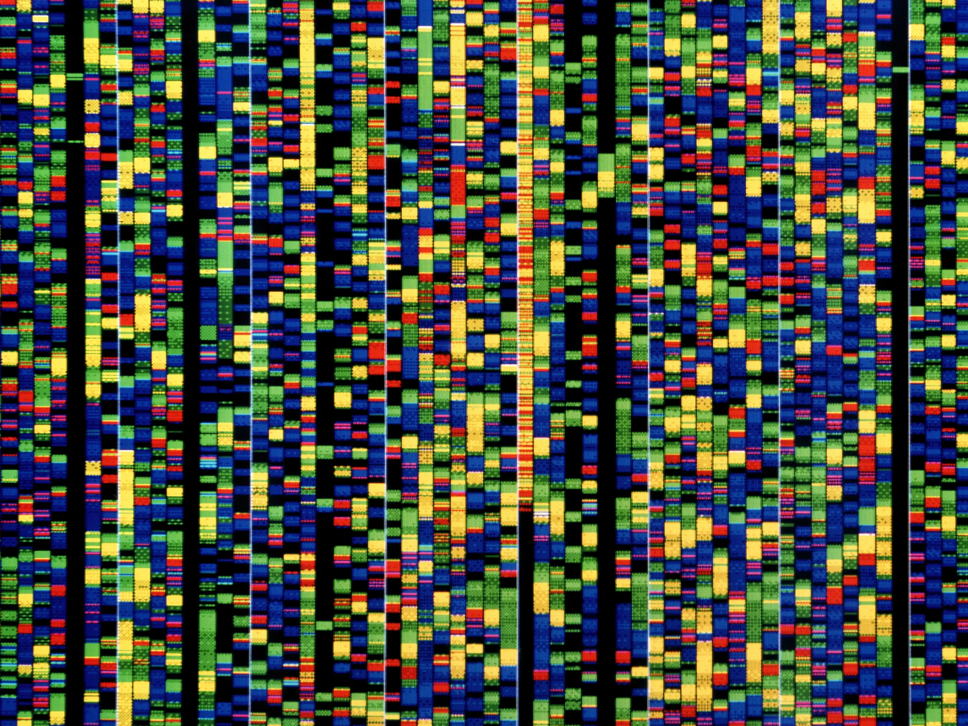
Hoe zouden we DNA kunnen lezen?

Slide 8
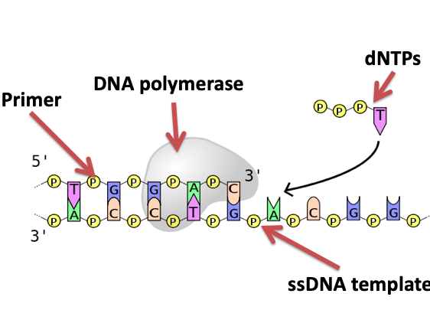
Sequencing by synthesis
These are the ingredients of many sequencing technologies
These are the ingredients of many sequencing technologies

Slide 9
Sanger sequencing: what we had before NGS
Introduced in 1977
A template is denatured to form single strands and extended with a polymerase in the presence of dideoxynucleotides (ddNTPs) that cause chain termination.
Typical read lengths are up to 800 base pairs. For the sequencing of Craig Venter’s genome (2007; first whole genome of an individual), Sanger sequencing was employed because of its relatively long read lengths.

Slide 10
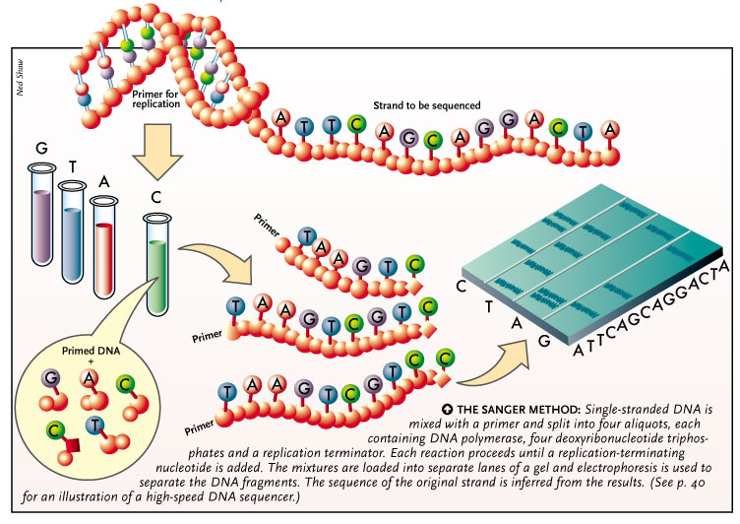

Slide 11
Human genome sequencing
We currently obtain whole genome sequences at 30x to 50x depth of coverage. For a typical individual:
2.8 billion base pairs are sequenced
~3-4 million single nucleotide variants
~600,000 insertions/deletions (indels)
Cost (research basis) is <$2000 per genome
We try to sequence mother/father/child trios

Slide 12
Human genome sequencing
We currently obtain whole genome sequences at 30x to 50x depth of coverage. For a typical individual:
2.8 billion base pairs are sequenced
~3-4 million single nucleotide variants
~600,000 insertions/deletions (SNPs)
Cost (research basis) is <$2000
We try to sequence mother/father/child trios
We also can enrich the collection of exons (“whole exome sequencing”). For a typical individual:
60 million base pairs are sequenced
There are ~80,000 variants
There are ~11,000 nonsynonymous SNPs

Slide 13
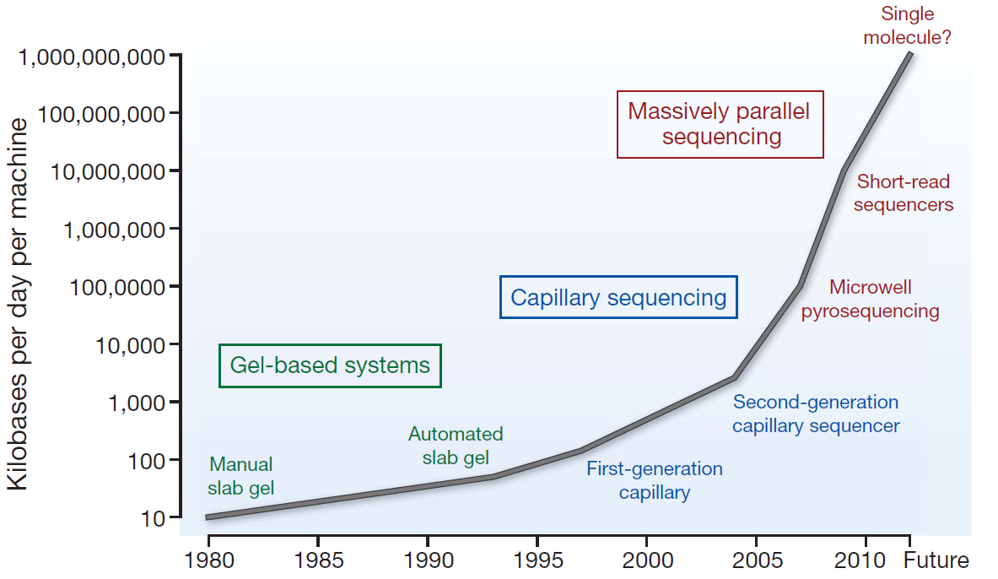
Sequencing (r)evolution
Stratton, nature 458, 719-724, 2009

Slide 14
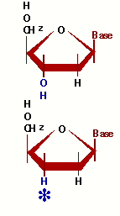
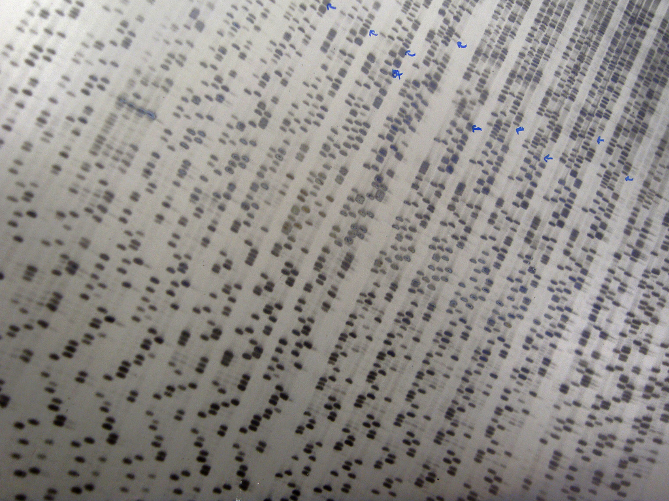
Gel based sequencing
Amplification stops when a Dideoxynucleotide is integrated

Slide 15
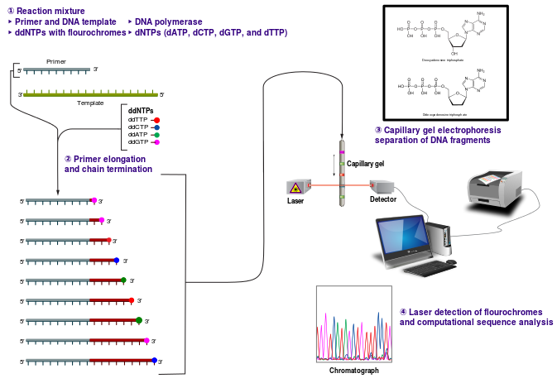
Capillary sequencing

Slide 16
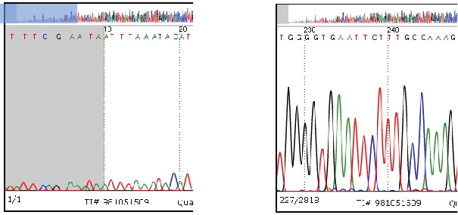
Examples of Sanger sequencing traces
Low quality reads
High quality reads

Slide 17
Massive parallel sequencing = Next Generation Sequencing

Slide 18
NGS
Denotes the family of sequencing platforms that have in common their high degree of parallelization and massive data generation.
NGS refers to the sequencing techniques that have succeeded Sanger (dideoxy) sequencing
An unlucky name, since a new generation after NGS is already around (→ NNGS?)

Slide 19
Hoe zouden we SNEL DNA kunnen lezen?

Slide 20
What NGS technologies DON’T offer is: targeted, high accuracy sequencing of small regions
1
What NGS technologies DO offer is: massive data generation of whole genomes, chromosomes, transcriptomes, exomes etc.
2

Slide 21
Sequencing technologies: goals
More data for less money
Longer reads!!

Slide 22
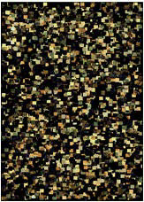
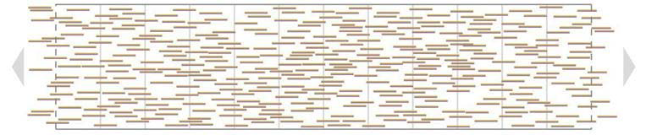

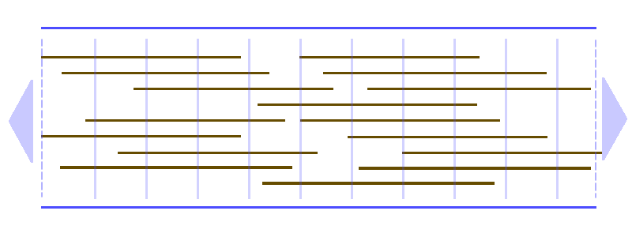
The read length race
Why are longer reads so desirable?

Slide 23
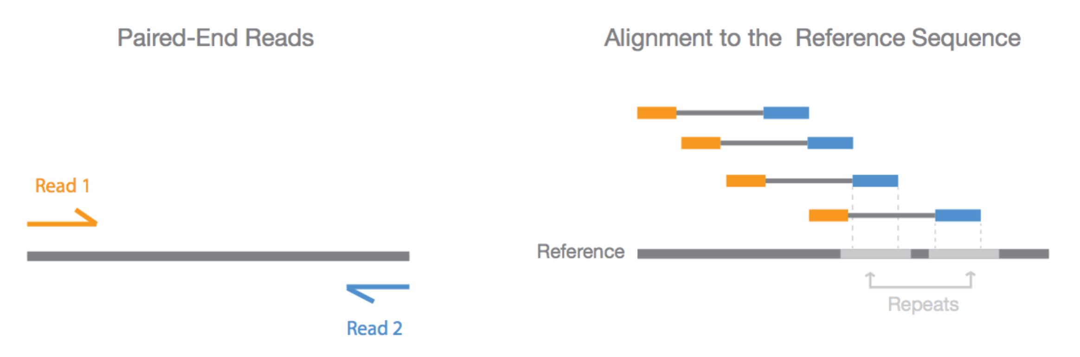
Why read pairs?
In Paired-end sequencing, both ends of the DNA fragment are sequenced
Because the distance between each paired read is known, alignment algorithms can use this information to map the reads over repetitive regions more precisely.
www.illumina.com

Slide 24
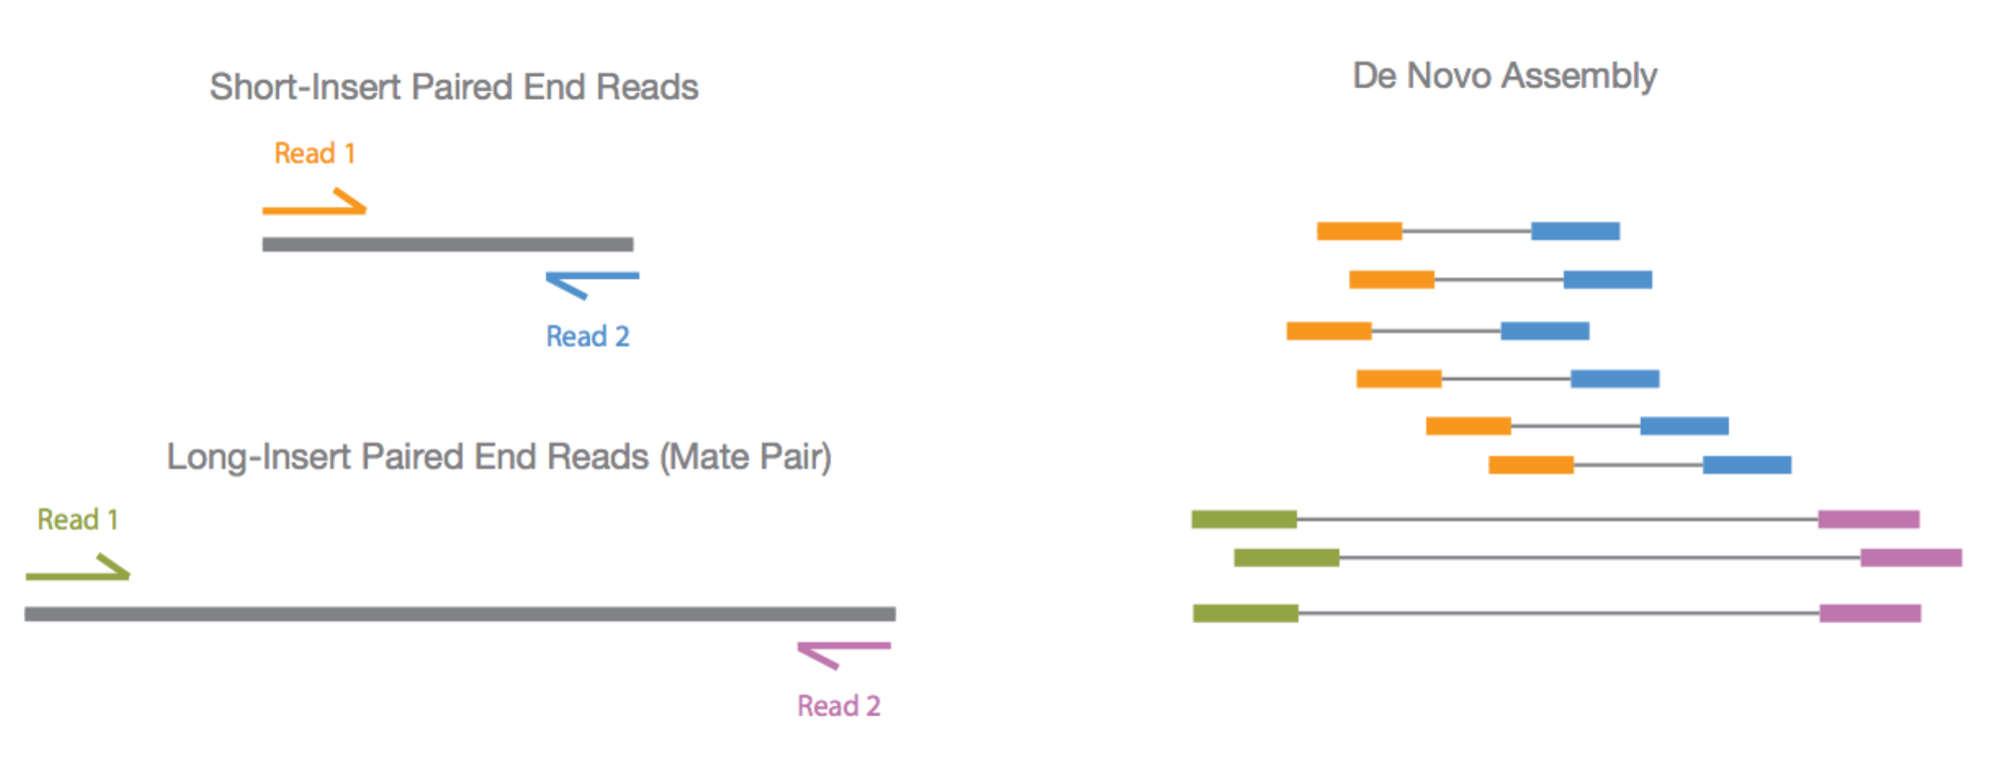
Read pairs versus Mate pairs
Because larger inserts can pair reads across greater distances, they provide a better ability to read through highly repetitive sequences and regions where large structural rearrangements have occurred
www.illumina.com

Slide 25

Why does paired end sequencing help assembly?

Slide 26
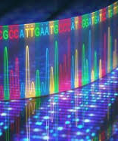

Sequencing platforms

Slide 27
Main NGS sequencing platforms
Single-molecule real-time sequencing
(Pacific Bio)
Ion semiconductor (Ion Torrent sequencing)
Pyrosequencing (454)
Sequencing by synthesis (Illumina)
Sequencing by ligation (SOLiD sequencing)
MinIon (Oxford nanopore)

Slide 28
Next-generation sequence technologies
Technology | Read length (bp) | Reads per run | Time per run | Cost per megabase | Accuracy
Roche 454 | 700 | 1 million | 1 day | $10 | 99.9%
Illumina | 50-250 | <3 billion | 1-10 days | ~$0.10 | 98%
SOLiD | 50 | ~1.4 billion | 7-14 days | $0.13 | 99.9%
Ion Torrent | 200 | <5 million | 2 hours | $1 | 98%
Pacific Biosciences | 2900 | <75,000 | <2 hours | $2 | 99%
Sanger | 400-900 | N/A | <3 hours | $2400 | 99.9%
Source: adapted from Wikipedia 1/11/13

Slide 29
Comparison of next-generation sequencing platforms

Slide 30
Whole genome sequencing (WGS) costs
have declined dramatically

Slide 31
Principles of 2nd generation NGS sequencers
Clonal amplification
Emulsion PCR → Roche / Ion Torrent
Bridge PCR → Illumina
Sequencing in cycles (Short reads)
454
Illumina
Ion Torrent/Proton

Slide 32

Cycle termination sequencing (Illumina)
Disadvantage:
Short read length (~150 bases)
Advantages:
Very fast
Low cost per base
Large throughput; up to 1 gigabase/epxeriment
Short read length makes it appropriate for resequencing
No need for gel electrophoresis
High accuracy
All four bases are present at each cycle, with sequential addition of dNTPs. This allows homopolymers to be accurately read.

Slide 33
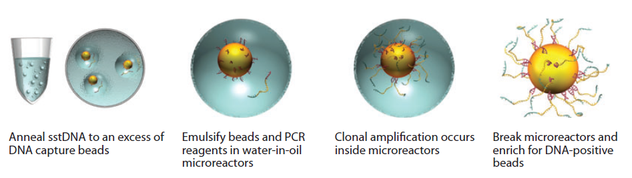
454 (Roche), SOLiD and Ion Torrent use Emulsion PCR for amplification

Slide 34

layout
Roche 454
Ion Torrent
Solid system
Pacbio
Nanopore
Helicos

Slide 35
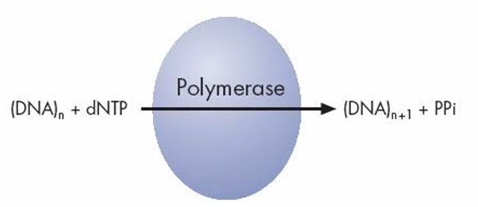
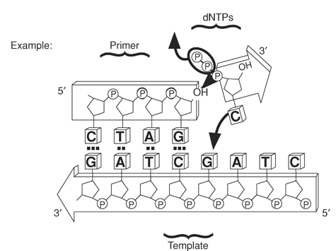
Roche 454: pyrosequencing
PPi

Slide 36
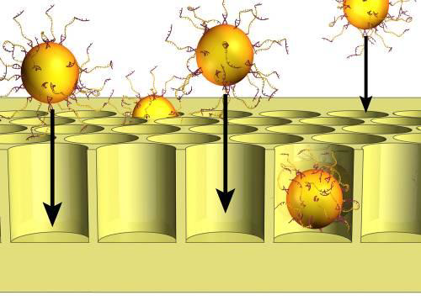
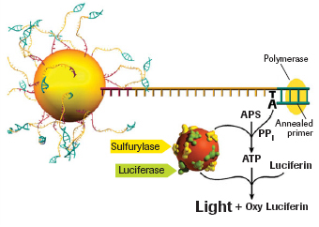
Roche 454: pyrosequencing
APS = Adenosine 5’-phosphosulfate

Slide 37
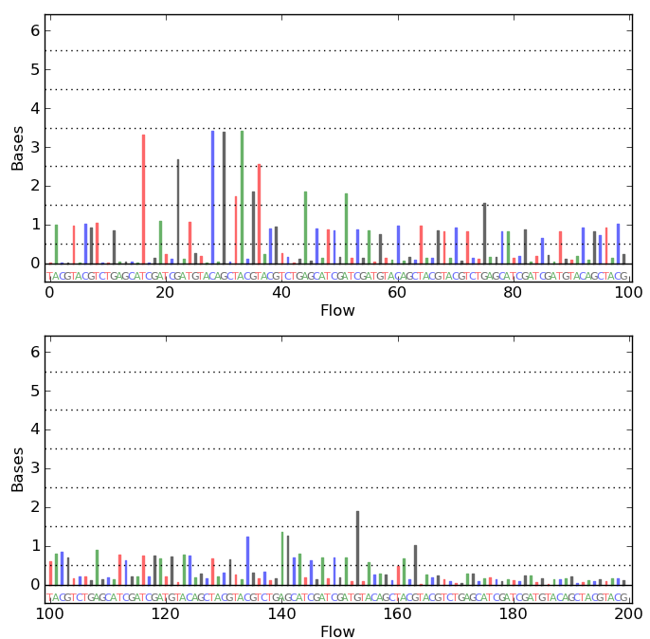
Roche 454: pyrosequencing
The big weakness of 454 sequencing: homopolymers give fast increasing error rate with increasing length
mammoth.psu.edu
Notes:
What are the downstream effects when analyzing a read with (long) homopolymer?

Slide 38
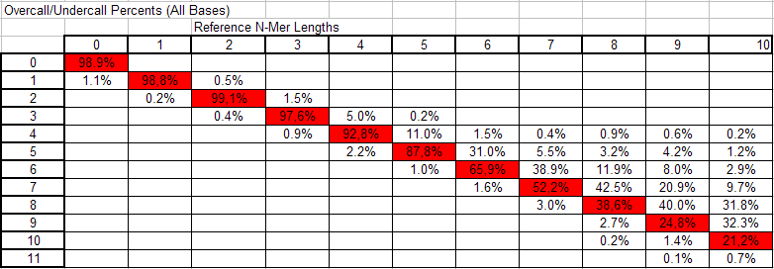
The Roche 454 homopolymer problem
movie
Notes:
Column 1 does not add up to 100%!

Slide 39
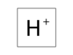
Ion Torrent sequencing
+H⁺
PPi

Slide 40
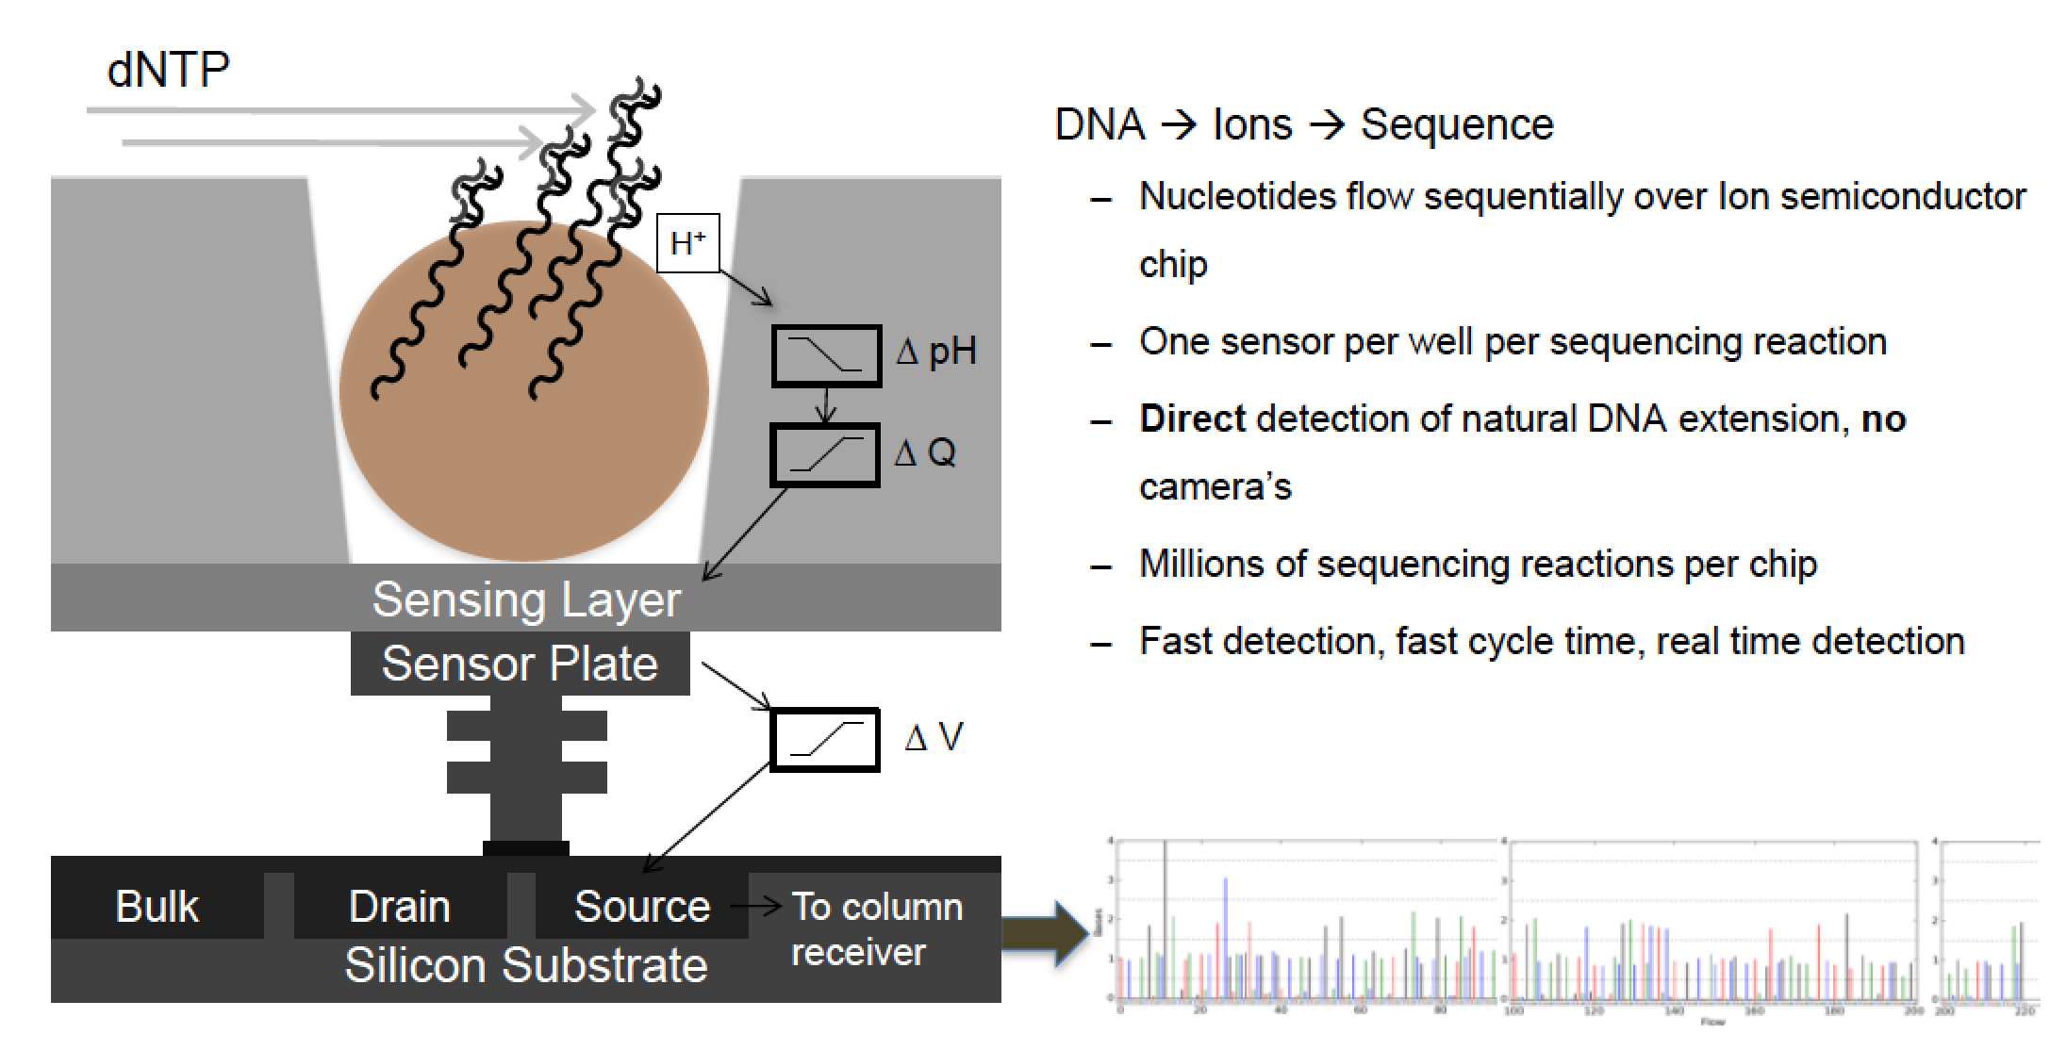
Ion Torrent sequencing
movie

Slide 41
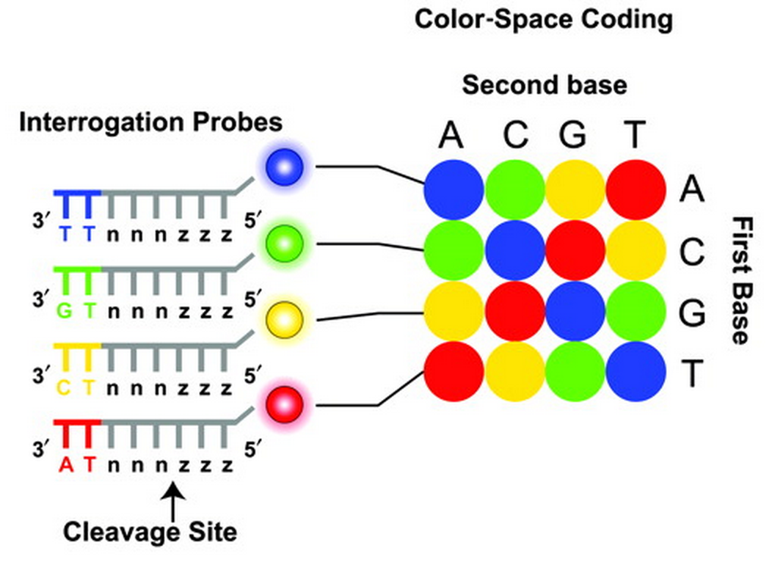
SOLiD sequencing
Sequencing by ligation
1600 million (!!) reads per run (160 Gb data)
Max 75 bases read length
Does not sequence bases but rather dinucleotidess

Slide 42
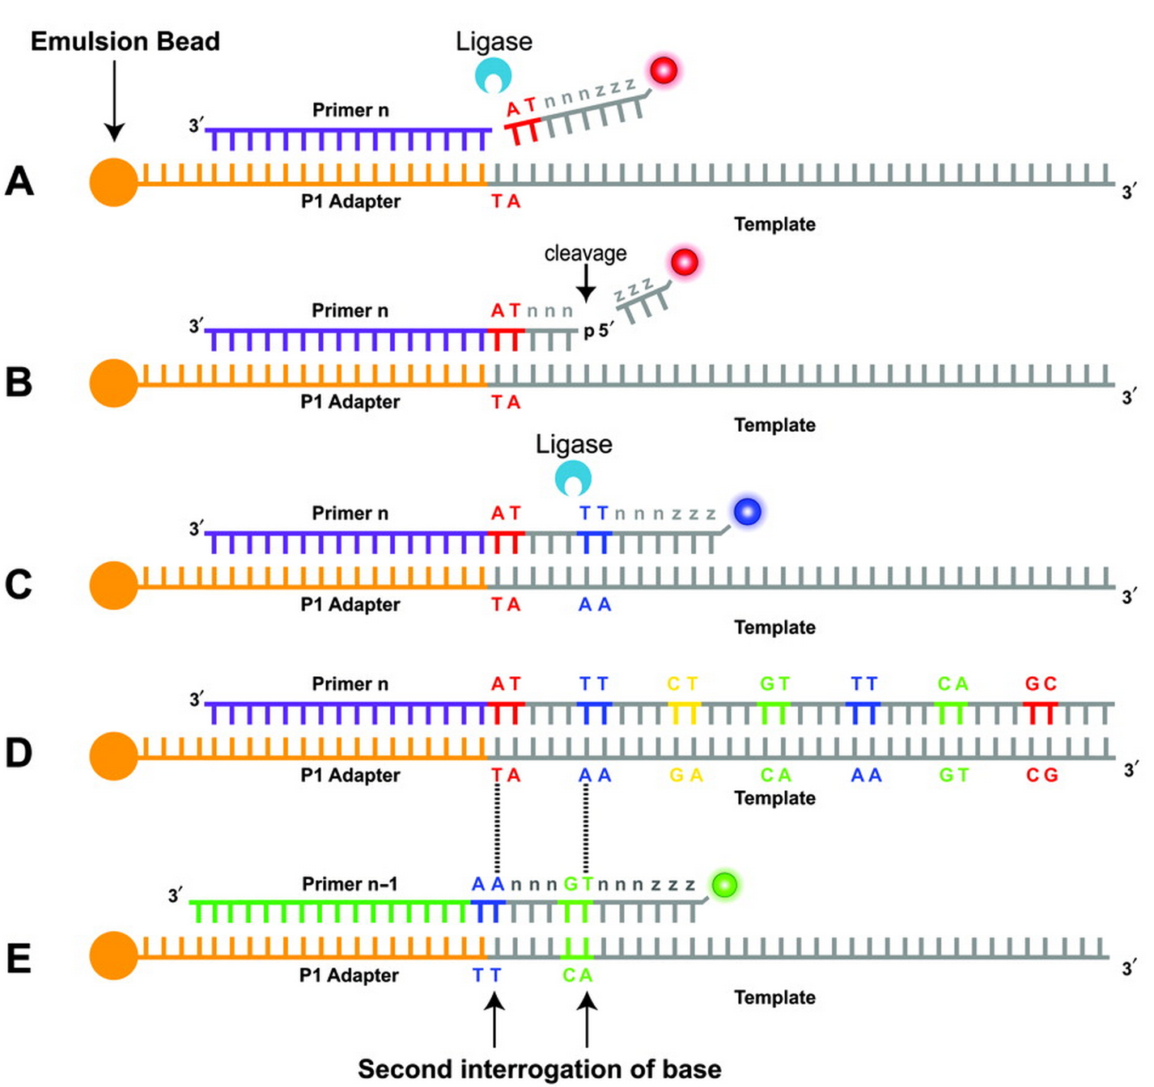
SOLiD sequencing

Slide 43
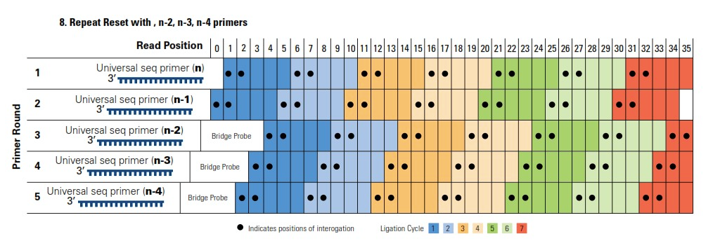
SOLiD sequencing

Slide 44
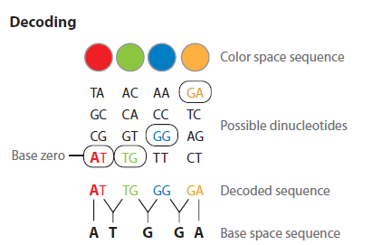
SOLiD sequencing
movie

Slide 45
Single molecule sequencers
PacBioRS
Oxford Nanopore
Helicos
No amplification required for the reads
Longer Read (excluding Helicos)
Base modification detection (excluding Helicos)

Slide 46
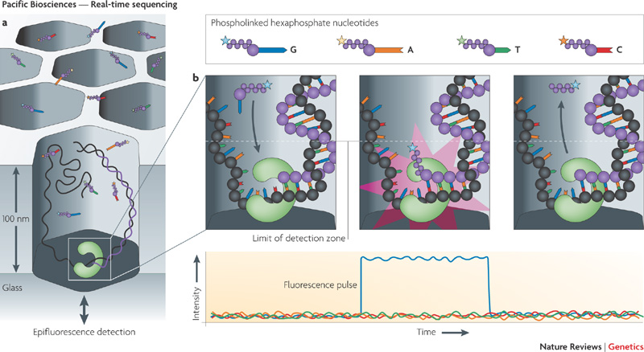
Single molecule sequencers - PacBio
2-3 kb single continuous read!
High (>10%) error rate!
movie

Slide 47
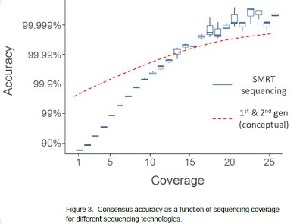
Is a high error rate bad per se?
Not with high coverage
Not with low systematic error rate!
Notes:
Coverage for mutation call in Diagnostics department minimum 5 (in Nextgene) and 20 in Cartagenia. Average coverage 300!

Slide 48
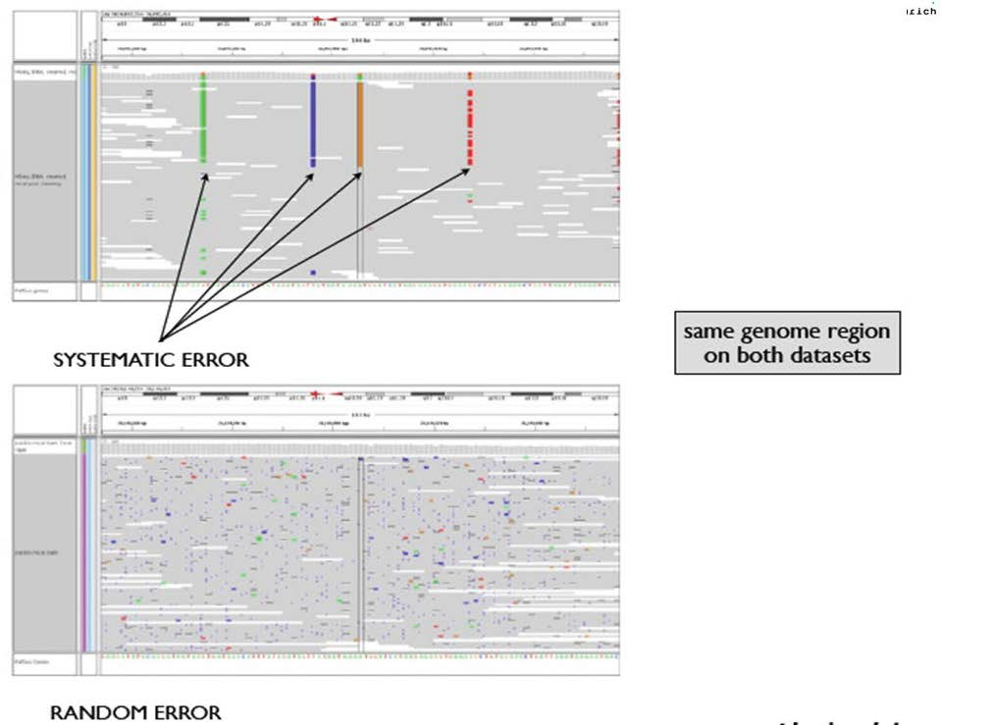
Systematic versus random errors
HiSeq
PacBio

Slide 49
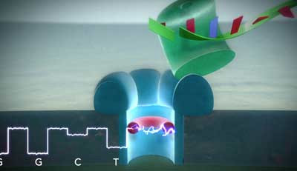
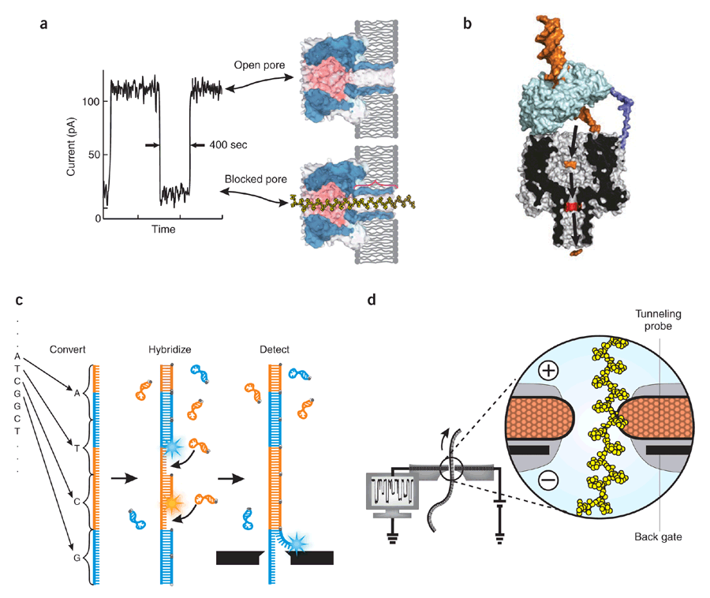
Single molecule sequencers – Oxford Nanopore
No enzyme
or label!
movie

Slide 50
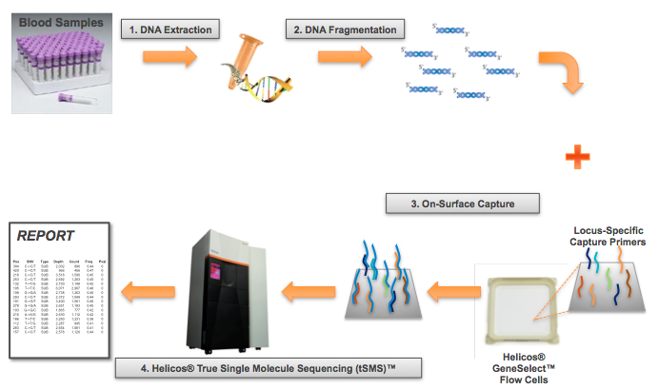
Helicos sequencing
Movie

Slide 51
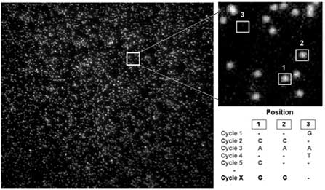

Slide 52
Single Molecule Sequencing = the future
Nanopores with electrical real-time analysis and without the need for optics, labels, amplification or fluidics looks like the next level of sequencing
But needs
Increased number of reads per run
Improved accuracy
Decreased reagent costs

Slide 53
Part 2 Overview of NGS technologies and platforms

Slide 54
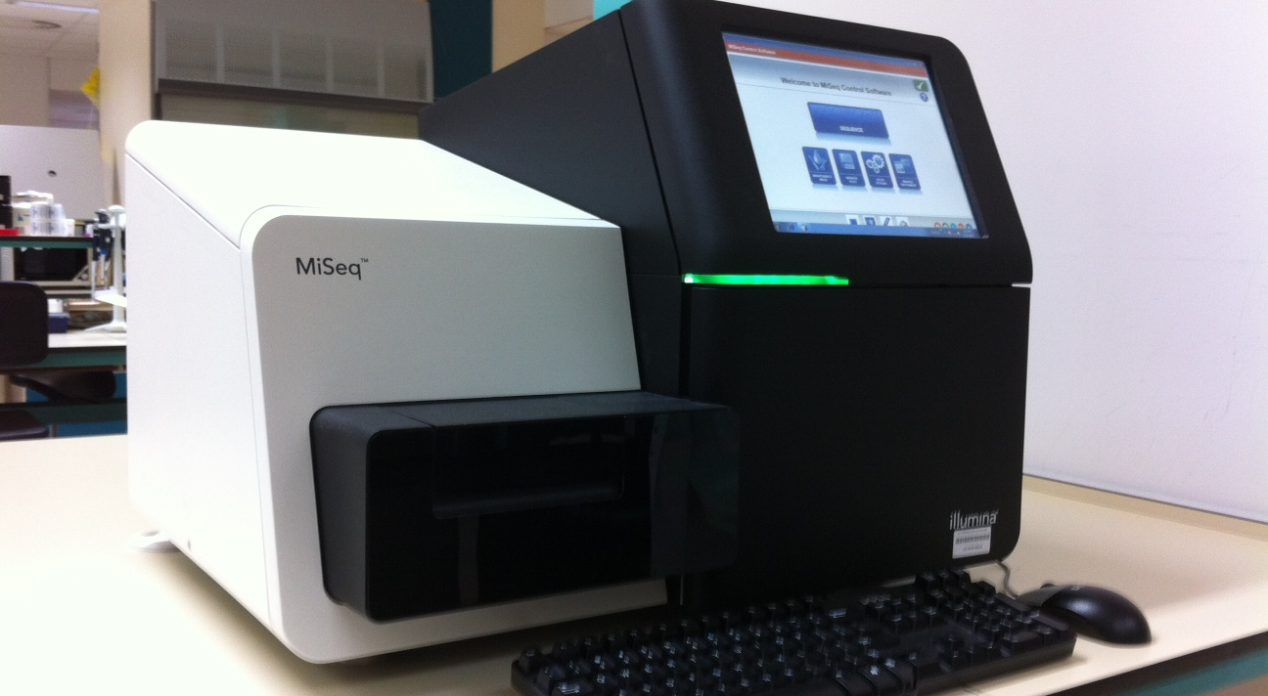
The Illumina platform
umcg/genetics

Slide 55
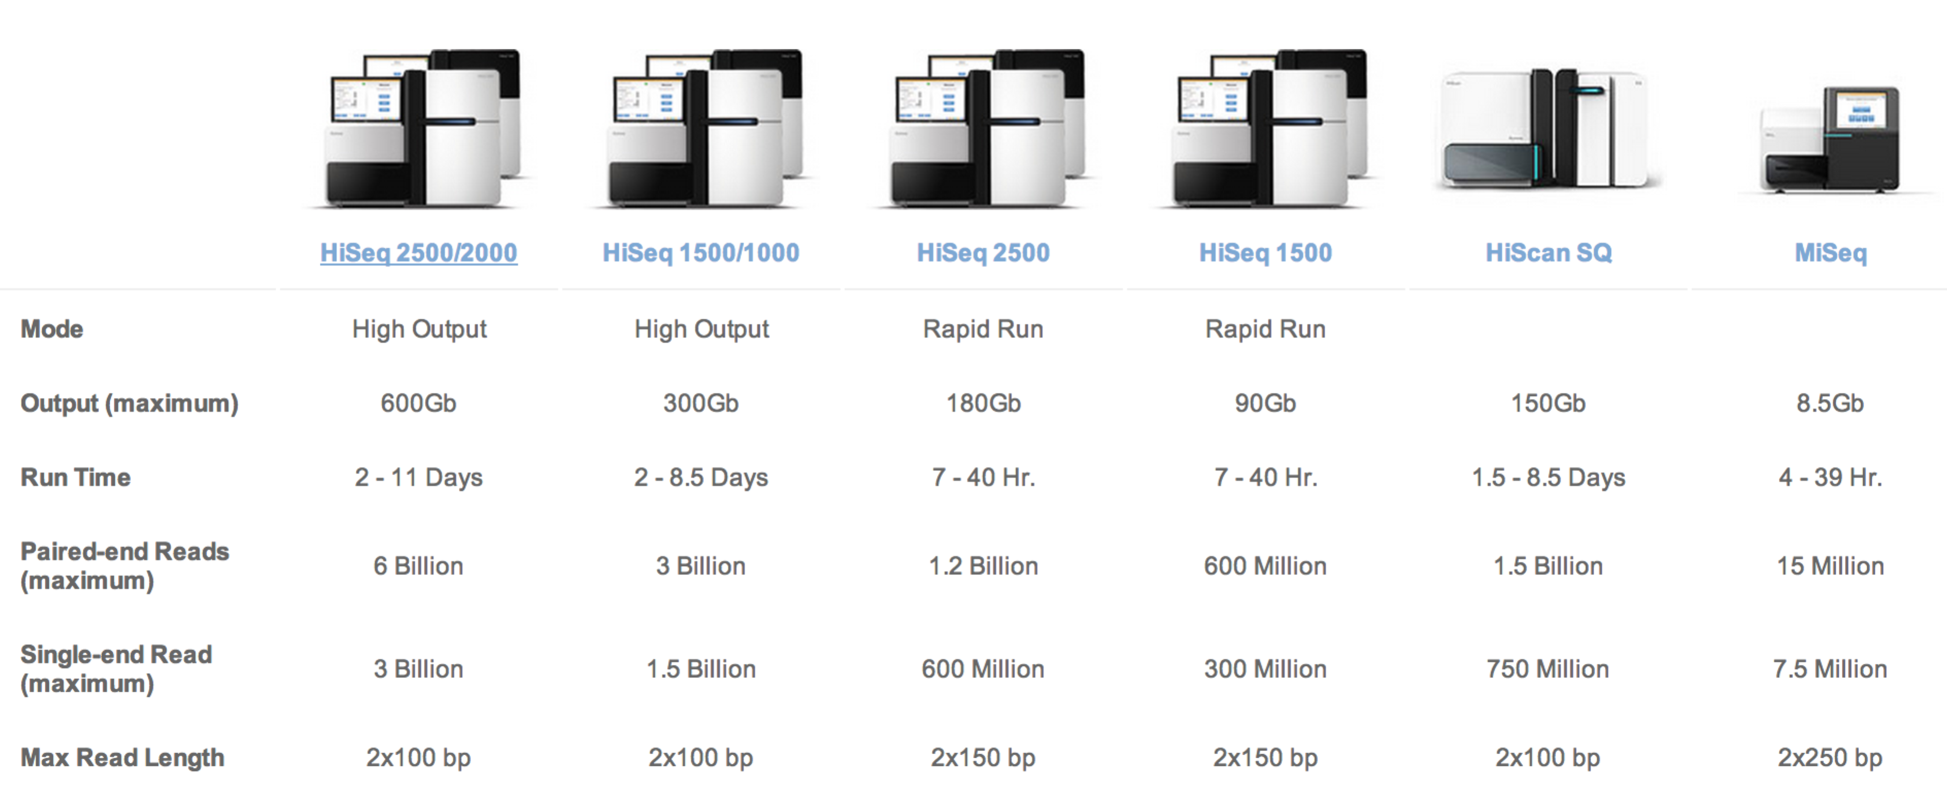
A sequencer for every need
www.illumina.com

Slide 56
The stages in Illumina sequencing
Sample preparation & target enrichment
Sequencing
Data processing

Slide 57
Sample preparation for Illumina
DNA isolation
QC on DNA prep
Fragment/shear DNA
Adapter ligation
Size selection (300-350 bp)
Amplification (=PCR) of selected fragments
QC of amplified material

Slide 58
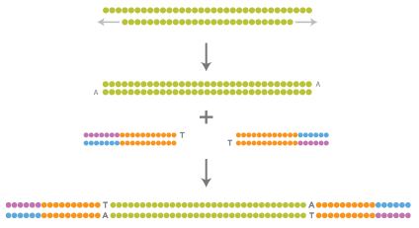
DNA processing summary
Repair and add Adenine overhang
Ligate adapters
Platform-specific oligonucleotide adapters, needed to perform the sequencing biochemistry and index samples, are ligated to each end of the fragments to yield the sequencing-ready library
www.illumina.com

Slide 59
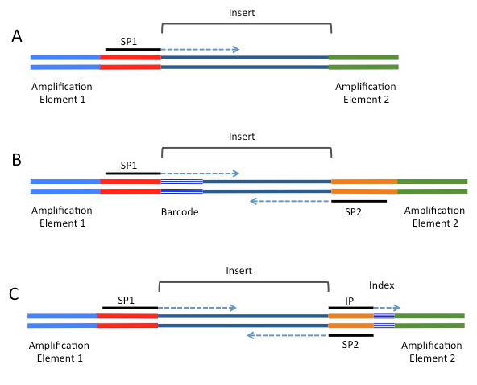
Adapters up close
Elements that can be included in NGS adapters on the Illumina platform.
SP1=primary sequencing primer; SP2=paired-end primer; IP=sequencing primer for the index read.
(A) Minimal adapter components. (B) Barcode configuration supporting a paired-end read. (C) Index configuration supporting a paired-end read.
Index’s can be used for upfront de-multiplexing
http://rnaseq.uoregon.edu

Slide 60
Optimal Illumina library profiles
Single peak at 340-390 bp (including adapters) with small size distribution
No primers present (peaks < 70 bp)
No empty library present: peak at 125-130 bp

Slide 61
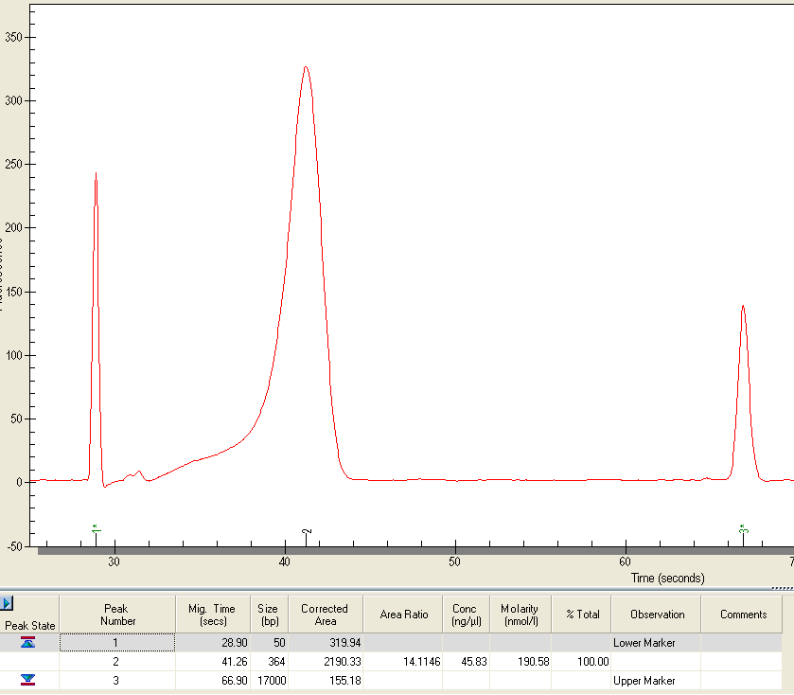
GIGO: Garbage in, Garbage out
364 Bp
Ideal situation!
Primer peaks

Slide 62
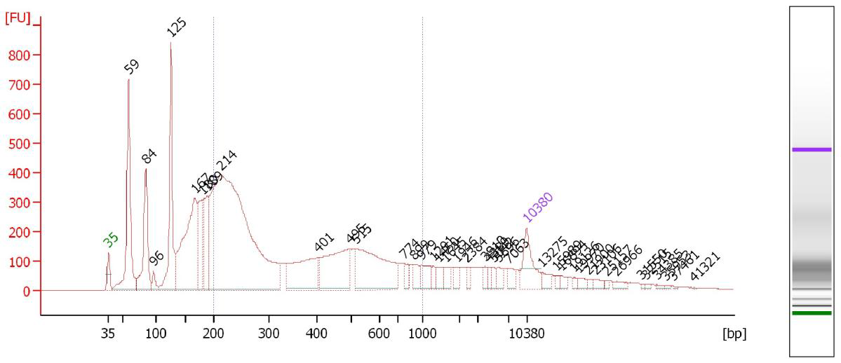
GIGO: Garbage in, Garbage out
Empty library peak at 125 bp
Primer peaks
at 59 & 84 bp
Bad situation!
Do not sequence this
Main peak at 214 bp too short for PE run

Slide 63
Targeted sequencing: Capturing of a panel of genes
Input: Prepped Genomic DNA
Custom made library kit (bait)
Hybridization
Magnetic Beads
Capture beads with magnet
Wash and elute beads
Amplify
QC of captured material
Pooling of 12 samples
Notes:
There are standard library kits available, such as SureSelect Whole Exome kit

Slide 64
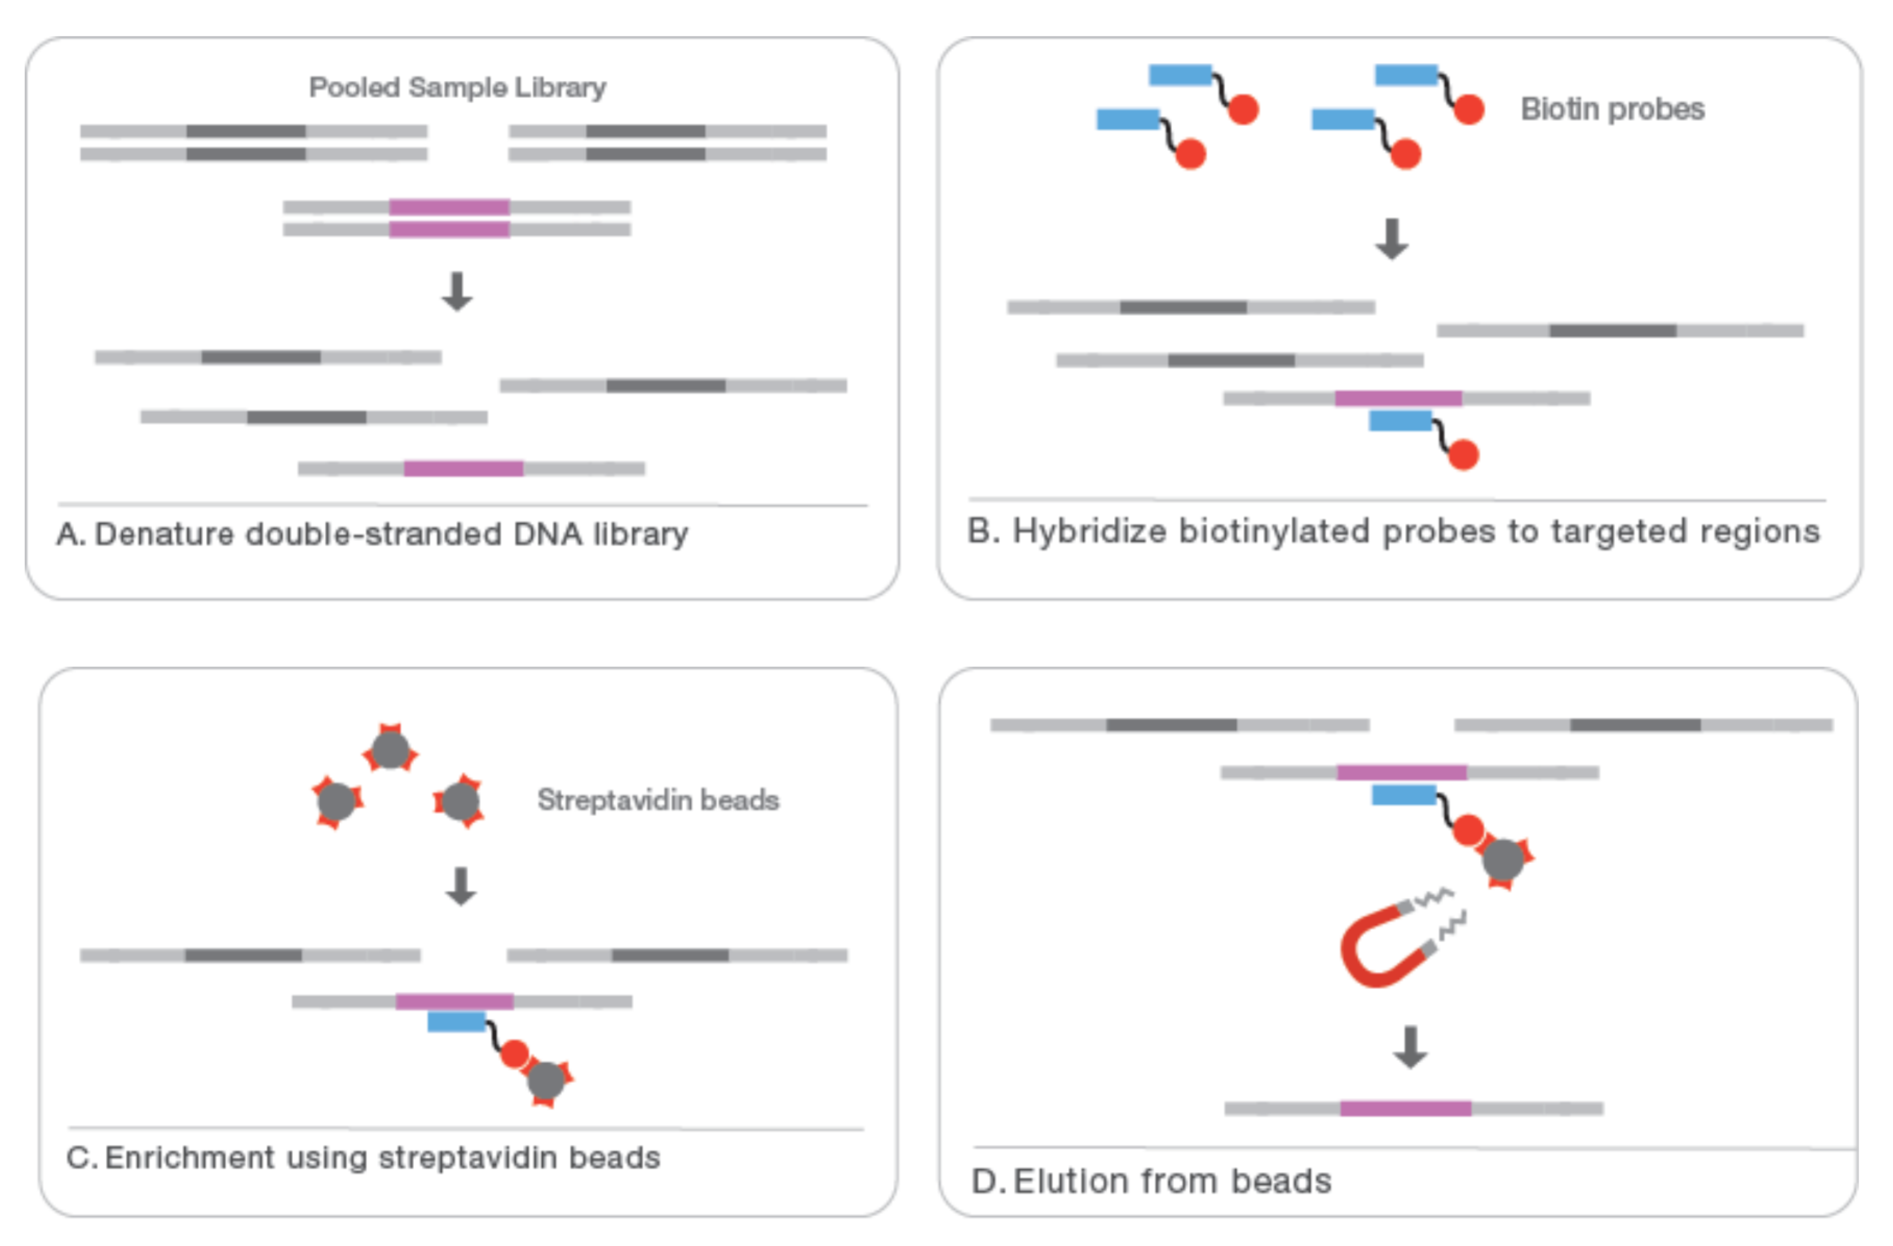
Target enrichment
www.illumina.com

Slide 65
Pros and cons of targeted sequencing
PROS
Cheaper (while capturing cost < sequencing cost)
Higher coverage
Decreased risk of unsolicited findings
Less variants to analyze

Slide 66
Pros and cons of targeted sequencing
CONS
New gene is discovered → new target set → validation etc + resequencing
You cannot identify new genes or pathways coverage
The capture may introduce (strand) bias
The true variant may be outside the region analyzed (e.g. intronic, UTR)
As sequencing gets cheaper the capture method may become too expensive

Slide 67
Sample pooling
Since one sequencing lane generates so much data, samples are pooled when less reads per sample are required
A sample-specific unique index (barcode) is added in last amplification step
Index: A 6-mer at an edit or Hamming distance of at least 2 (most 3) from any other index sequence to minimize the chance of mix-ups
Notes:
Not all indexes (or sequences) should start with the same base, otherwise the camera alignment will be problematic

Slide 68
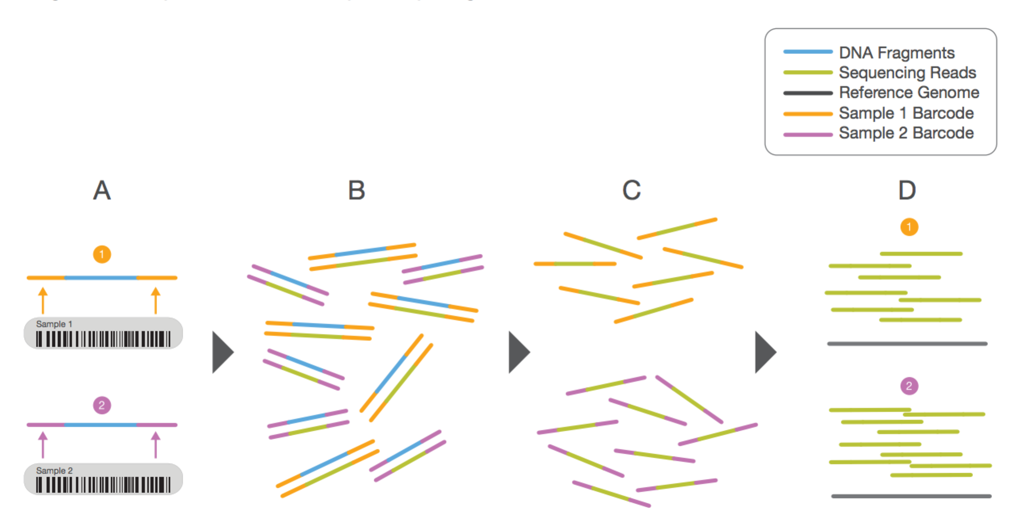
Multiplexing using barcodes
www.illumina.com

Slide 69
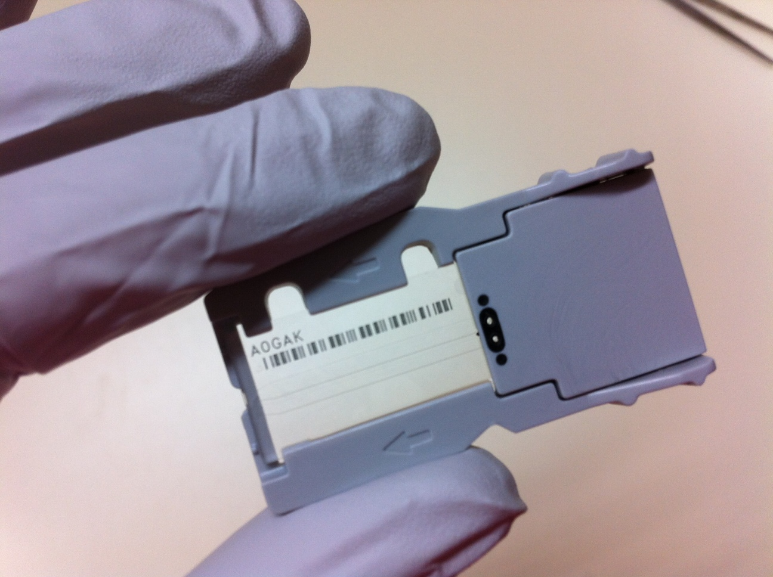
The actual sequencing
The sequencing process on Illumina is a sophisticated process of fluidics
DNA templates are attached to a flow cell
All sequencing steps are performed by flowing reagents over the attached DNA

Slide 70
Illumina sequencing technology in 12 steps
1. Prepare genomic DNA
2. Attach DNA to surface
3. Bridge amplification
4. Fragments become double stranded
5. Denature the double- stranded molecules
6. Complete amplification
7. Determine first base
8. Image first base
9. Determine second base
10. Image second chemistry cycle
11. Sequencing over multiple chemistry cycles
12. Align data

Slide 71
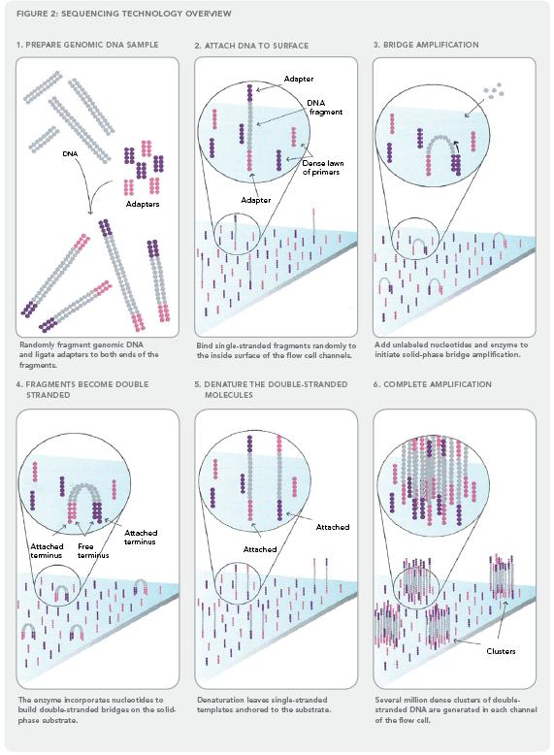
Illumina sequencing technology in 12 steps
1. Prepare genomic DNA
2. Attach DNA to surface
3. Bridge amplification
4. Fragments become double stranded
5. Denature the double- stranded molecules
6. Complete amplification
Source: http://www.illumina.com/downloads/SS_DNAsequencing.pdf
Notes:
71

Slide 72
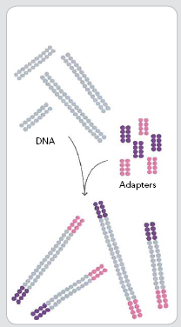
1. Prepare genomic DNA
2. Attach DNA to surface
3. Bridge amplification
4. Fragments become double stranded
5. Denature the double- stranded molecules
6. Complete amplification
DNA
adapters
Randomly fragment genomic DNA and ligate adapters to both ends of the fragments

Slide 73

The sequence of sequencing
Annealed sequencing primer
Attach DNA to flow cell
Bridge amplification to generate clusters
Denaturing and annealing of sequence primers
Sequencing in 100-150 cycles
The reverse strands are cleaved and washed away and the sequencing primer is hybridized to the DNA-templates
www.illumina.com

Slide 74
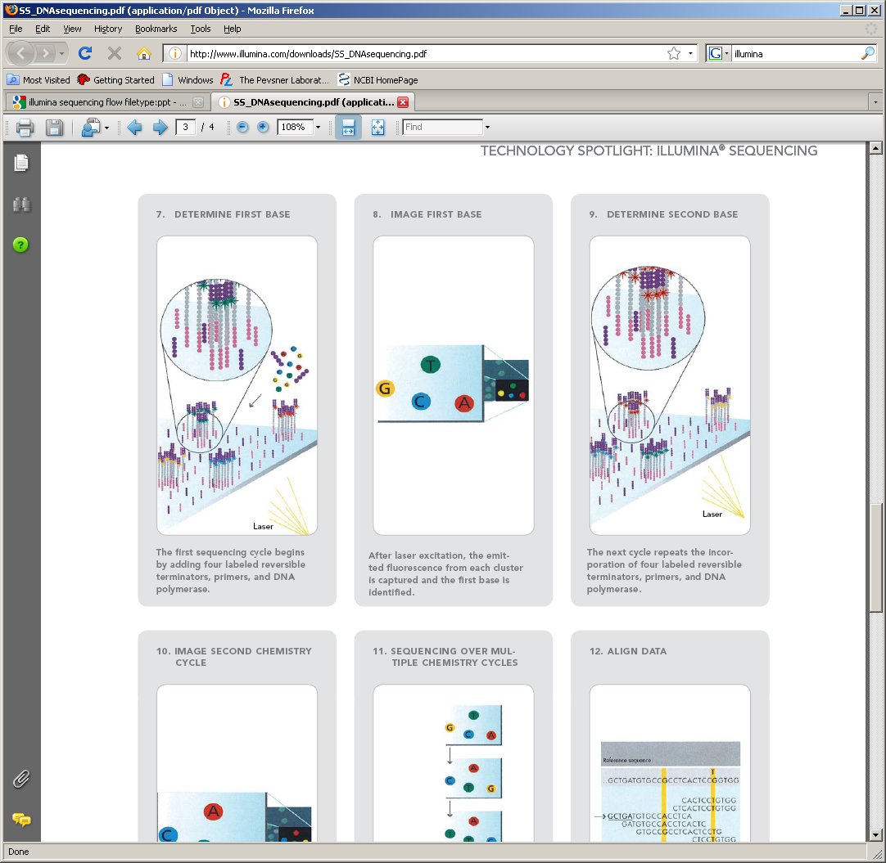
7. Determine first base
8. Image first base
9. Determine second base
10. Image second chemistry cycle
11. Sequencing over multiple chemistry cycles
12. Align data
After laser excitation, the emitted fluorescence from each cluster is captured and the first base is identified

Slide 75
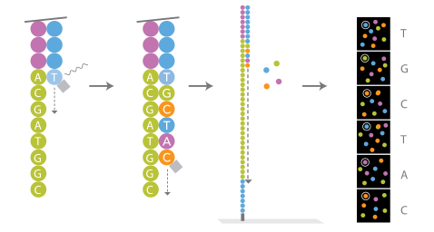
The sequence of sequencing
Attach DNA to flow cell
Bridge amplification to generate clusters
Denaturing and annealing of sequence primers
Sequencing in 100-150 cycles
Each base has its specific fluorescent label
A blocked base is attached to the end of the growing chain (or primer), detected by fluorescence and deblocked for the next cycle
www.illumina.com

Slide 76
7. Determine first base
8. Image first base
9. Determine second base
10. Image second chemistry cycle
11. Sequencing over multiple chemistry cycles
12. Align data
Laser
The next cycle repeats the incorporation of four labeled reversible terminators, primers, and DNA polymerase

Slide 77
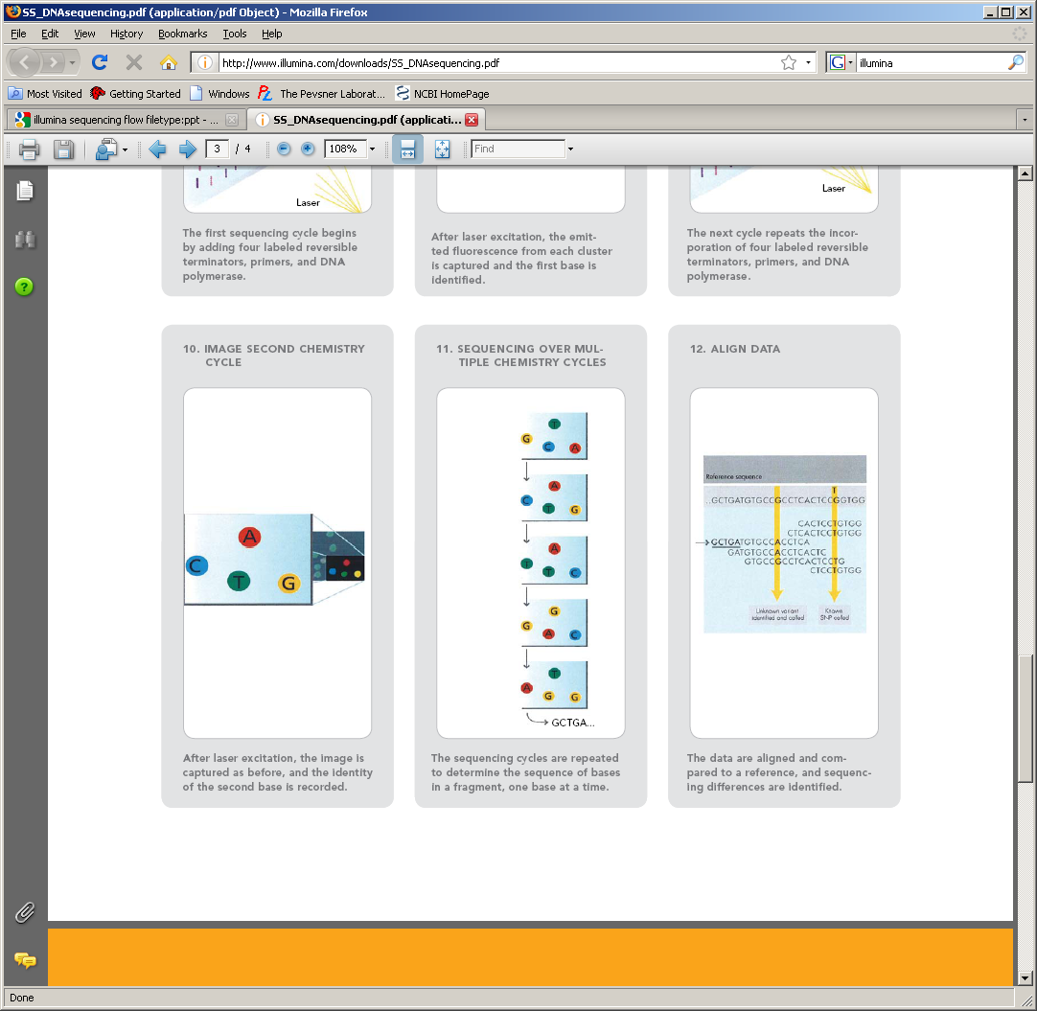
7. Determine first base
8. Image first base
9. Determine second base
10. Image second chemistry cycle
11. Sequencing over multiple chemistry cycles
12. Align data
After laser excitation the image is captured as before, and the identity of the second base is recorded.

Slide 78
7. Determine first base
8. Image first base
9. Determine second base
10. Image second chemistry cycle
11. Sequencing over multiple chemistry cycles
12. Align data
The sequencing cycles are repeated to determine the sequence of bases in a fragment, one base at a time.

Slide 79
Reference sequence
7. Determine first base
8. Image first base
9. Determine second base
10. Image second chemistry cycle
11. Sequencing over multiple chemistry cycles
12. Align data
Unknown variant identified and called
Known SNP called
The data are aligned and compared to a reference, and sequencing differences are identified.

Slide 80

Illumina sequencing movie

Slide 81
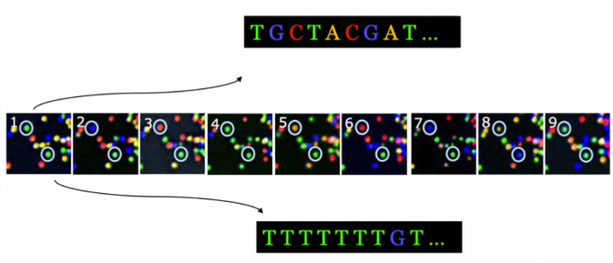
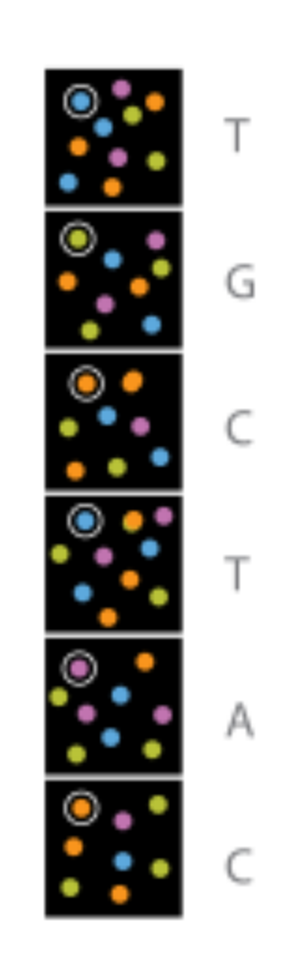
From image to sequence
The raw product of the sequencing reaction is a time-lapse series of images with fluorescent signals in an unordered grid
Theory
Ideal

Slide 82

From image to sequence (2)
Practice:
Dust specks
Proximity
Low signal
Noise
Degradation during cycles

Slide 83
From image to sequence (3)
The time-lapse series of images is transformed into a textual representation of nucleotides and the probability of false identity for each nucleotide
We call this process base calling
@HWI-962:64:D0BNFACXX:7:1101:1227:2119 1:N:0:GATCAG
TGCTACGAT
+
CCCFFFII9
@HWI-962:64:D0BNFACXX:7:1101:1176:2147 1:N:0:GATCAG
TTTTTTTGT
+
CCCFFFFFG
Sequence 1
Quality of sequence 1

Slide 84

Minimize technical variance through randomization
Avoid bias: don't order your samples in a logical way !!!
Example for 2 groups with 4 samples each
Notes:
In practice at Diagnostics dept 12 patient samples from same group

Slide 85
Sequencing strategies
De novo genomic sequencing
Genomic resequencing
Whole-genome
Target enrichment (exome, gene panel)
Metagenome sequencing
RNA-seq
ChIP-seq
Small RNA (miRNA) sequencing
etc

Slide 86

ChIP-seq
Chromatin ImmunoPrecipitation
Investigate Protein-DNA interactions
A Database:
https://chip-atlas.org

Slide 87

ChIP-seq: study of Transcription Factors
TFs are modular proteins that recognize specific DNA motifs
TFs regulate gene expression, and consequently many important cellular processes
TFs are often mutated or aberrantly expressed in human disease

Slide 88

ChIP-seq overview
Using Formaldehyde
wikipedia.org

Slide 89



Slide 90

ChIP-seq visualization
Find peaks → Peak is binding site of protein

Slide 91
ChIP-seq
Pros:
Protein-DNA interactions are detected as they occur in vivo
Quantitative (qPCR analysis)
Adaptable to genome-wide analysis
Can be performed for all proteins recruited to the DNA
Cons:
Requires suitable antibodies
Extremely inefficient (0.001-0.1% of input is recovered)
Low-affinity binding events are easily missed (antibody dependent)
Not a functional experiment on its own

